Slide 1

Transport Layer – UDP and TCP
CE3005: Computer Networks
CZ3006: Netcentric Computing
Prof.Mo Li
e-mail: limo@ntu.edu.sg
Location: N4-2b-61
School of Computer Science and Engineering

Slide 2
Contents
Transport Layer
  Port Numbers
Connectionless Service
  User Datagram Protocol (UDP)
Connection-Oriented Service
  Transmission Control Protocol (TCP)
Transmission Control Protocol (TCP)
  Connection Management
  Flow Control
  Error Control
  Congestion Control

Slide 3
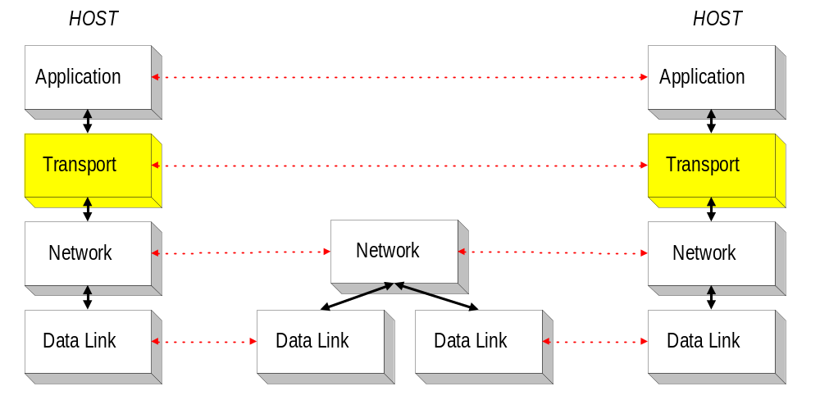
Transport Layer
Transport layer provides end-to-end service for transferring data between processes (process-to-process communication).
Only implemented at the end hosts.

Slide 4


Transport Layer - Ports
A single transport layer is used to support multiple application processes through the use of ports.
Hence, transport layer is also said to perform multiplexing/ de-multiplexing:
multiplexing: gathering data from multiple processes and passing it to a single network layer
Transport Layer
ports
de-multiplexing: delivering of data from single network layer to different processes correctly
Network Layer

Slide 5
Transport Protocols in the Internet
The Internet supports 2 main transport protocols:
UDP - User Datagram
Protocol
unreliable, connectionless
datagram oriented
simple
example applications:
  routing (RIP), domain name service (DNS), DHCP, real-time protocol, etc.
TCP - Transmission Control Protocol
reliable, connection-oriented
stream oriented
complex
example applications:
  web (http), email (smtp), file transfer (ftp), video streaming, etc.
UDP
TCP
Protocol 11₁₆
Protocol 06₁₆
IP

Slide 6
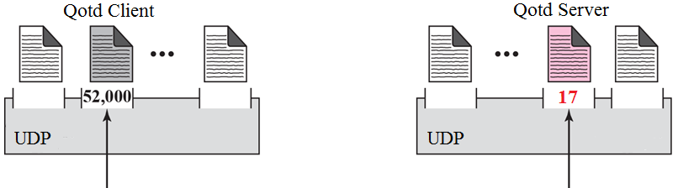
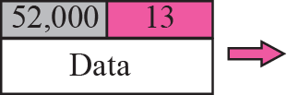
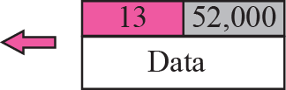
UDP – Datagram Service
Application layer is aware that UDP sends each message as a datagram.
e.g. in Java, request = new DatagramPacket();
well-known port
ephemeral port
17
client request
server reply
17
Destination port number

Slide 7
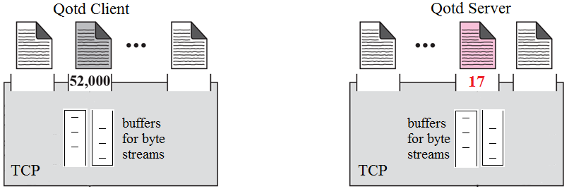
TCP – Byte Stream Service
Application layer views TCP as a channel for sending stream of bytes, and is NOT aware that bytes are sent in blocks called segments.
e.g. in Java, outStream = socket.getOutputStream();
request = outStream.write(message);
segment
17

Slide 8
User Datagram Protocol (UDP)
Q: If UDP provides non-reliable communications, then why UDP?
A: Some applications do not need reliable communications. For example:
  Broadcasting, advertising messages to users.
  Sending live video streams over the Internet (loss tolerant, rate sensitive).
Q: So, what does UDP do?
A: Provide process-to-process communication service for applications to use.

Slide 9
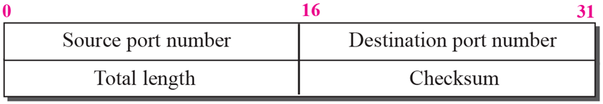
UDP Header Format
Length of UDP datagram including header (in bytes):
Minimum – 8 (i.e. no data, only header)
Maximum – 65535

Slide 10
Transmission Control Protocol
To support applications requiring reliable communications, TCP adds reliability over unreliable IP.
Essentially, TCP features:
  Connection Management: A connection must be setup before data exchange can be performed.
  Flow Control: Sender will not overwhelm receiver.
  Error Control: Receiver detects errors, sender retransmits error packets.
  Congestion Control: During transmission, sender detects network usage(congestion) and adjust transmission rate.

Slide 11
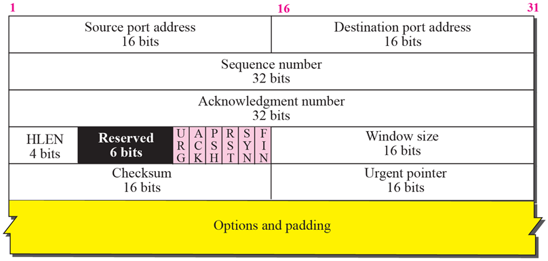
TCP Header Format
Header length, in multiples of 4 bytes, typically 5 = 20 bytes.
For error detection, ignore.
For urgent data, typically not used - ignore.
Typically not used, ignore.

Slide 12
TCP Header Format
Port addresses
Port address | Type | Description of use
0-1023 | Well Known port | Used by system processes to provide network services
1024-49151 | Registered port | Assigned by IANA upon request by entities. Can also be use by user.
49152-65535 | Ephemeral port | Dynamic or private ports that cannot be registered by IANA

Slide 13
TCP Header Format
Sequence Number (SN):
  Each TCP connection will start with a different SN called Initial Sequence Number (ISN)
  The position of each data byte in the byte stream is labelled from ISN+1, and cycle back to 0 once reaching 2³² -1; i.e. 1st byte (ISN+1) mod 2³², 2nd byte (ISN+2) mod 2³², …
  SN indicates the position of the 1st byte in each segment
Acknowledgement Number (AN):
  AN of the next data byte expected from sender
  Also imply all bytes up to AN-1 have been received correctly
Window Size (W):
  Indicate the number of bytes (also called credits) counting from AN that the receiver is ready to accept
Note: Other fields will be discussed in relevant slides later.

Slide 14
TCP Connection Management
Connection establishment: serves the following purposes
  ensure both ends are ready to communicate
  establish initial sequence number (ISN)
  exchange parameter, e.g. window size (in bytes)
  allocate resources, eg. buffer space, etc. to support the connection
Connection establishment starts with a synchronization (SYN) request.

Slide 15
Control Bits
SYN = 1: Synchronize sequence numbers
  Used to establish connection
FIN = 1: No more data from me!
  Used to terminate connection
RST = 1: Reset the connection
  Used when error occurs during connection establishment
ACK = 1: Acknowledgment number is valid

Slide 16

TCP: Connection Establishment
TCP uses 3-way handshake approach with positive acknowledgements (why not just 2-way?)
Host A
Host B
(Client)
(Server)
passive open
LISTEN
active open SYN-SENT
SYN(SN=clnt_ISN)
SYN+ACK(SN=svr_ISN, AN=clnt_ISN+1)
SYN-RCVD
ESTABLISHED
ACK(SN=clnt_ISN+1, AN=svr_ISN+1)
ESTABLISHED

Slide 17
Two-way Handshake without positive acknowledgement
Hosts A & B use a two-way handshake for connection setup. They exchange their ISN with each other.
A
B
active open
SYN-SENT
passive open
LISTEN
SYN(SN=100)
SYN(SN=300)
ESTABLISHED
ESTABLISHED
DATA
SN=101
Data exchange doesn’t seem to have any problem. But…
(ok)

Slide 18
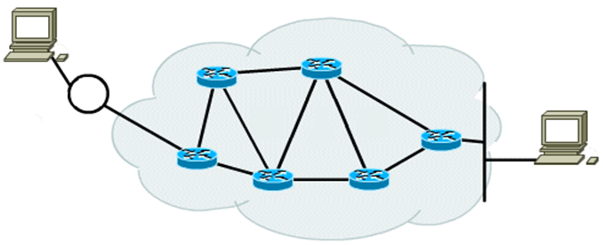
Recall that IP is unreliable. It is possible for packets to be delayed, lost, or duplicated due to timeout re-sent by TCP.
New SYN packet from A is sent to B but unfortunately it’s lost!
host A
host B
Old SYN packet from A is finally going to B after being delayed by congested router.

Slide 19
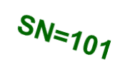
Two-way Handshake Problem
A
B
This was an old delayed connection request.
Lost! (New connection happened to re-use same port number.)
SYN(SN=90)
SYN
(SN=100)
B didn’t know this was an old SYN. B accepts and responds.
active open
SYN-SENT
passive open
LISTEN
SYN
(SN=300)
ESTABLISHED
DATA of seqn=91 to 100 will never arrive!!!
B will face problem processing the DATA!!!
ESTABLISHED
DATA
(ok, but also expecting DATA seqn=91 ???)

Slide 20
Solution: Three-way Handshake
Synchronization can be made reliable if each connection request is positively acknowledged.
that is
reduced
to 3-way
OPEN
SYN x
OPEN
SYN x
ACK x+1
ACK
SYN y,
ACK x+1
OPEN
SYN y
OPEN
ACK
ACK y+1
ACK
ACK y+1

Slide 21
Three-way Handshake
(Put to test)
A
B
SYN(SN=90)
SYN
(SN=100)
passive open
LISTEN
active open
SYN-SENT
AN ≠ SN+1 (latest SYN)
SYN-RCVD
SYN+ACK
(SN=300,AN=91)
Host A requests a reset (RST) on connection setup
(error!)
CLOSED
RST(SN=91)
(abort)
LISTEN

Slide 22
TCP: Connection Termination
Host A
Host B
FIN:Finish
active close
FIN-WAIT-1
FIN (SN=x)
ACK immediately
CLOSE-WAIT
ACK(SN=y,AN=x+1)
Half-close
FIN-WAIT-2
Now, A cannot send to B, but B can still send to A.
active close
LAST-ACK
FIN (SN=y,AN=x+1)
ACK immediately
TIME-WAIT
ACK (AN=y+1)
“Normal” Close
CLOSED

Slide 23
TCP: Connection Termination
(another scenario)
Host A
Host B
FIN:Finish
active close
FIN-WAIT-1
FIN (SN=x)
ACK immediately
LAST-ACK
FIN+ACK
(SN=y,AN=x+1)
ACK immediately
TIME-WAIT
ACK (AN=y+1)
CLOSED
When B does not have outstanding data to send to A when receiving FIN from A.

Slide 24
TCP: Connection Termination
(Numerical example)
Host A
Host B
FIN:Finish
active close
FIN-WAIT-1
FIN (SN=501, AN=301)
ACK immediately
LAST-ACK
FIN+ACK
(SN=301,AN=502)
ACK immediately
TIME-WAIT
ACK (SN=502,AN=302)
CLOSED

Slide 25
SN
Note:
  A SYN and FIN segment does not carry data but consumes one sequence number
  A SYN +ACK, FIN+ ACK does not carry data but consumes one sequence number
  ACK segment, carrying no data, does not consume any sequence number.

Slide 26
TCP Header Format

Slide 27
Sequence Number (SN)
32 bit, range: 0 ~ 2³²-1
Each connection starts with a different SN called Initial Sequence Number (ISN)
The position of each data byte in the byte stream is labelled from ISN+1, and cycle back to 0 once reaching 2³² -1
SN of a TCP segment indicates the position of its 1st data byte in a data stream
Byte stream to be sent, ISN=11
11
12
13
14
15
16
17
18
19
20
21
22
….
segment
SN=11
segment
SN=15
segment
SN=20

Slide 28
Acknowledgement Number & Window Size
Acknowledgement Number (AN):
  SN of the next data byte expected from sender
  Imply all bytes up to AN-1 have been received correctly
Window Size (W):
  The number of bytes counting from AN that the receiver is ready to accept
segment, SN=11
Sender
11
12
13
14
15
16
17
18
19
20
21
22
….
acknowledgement, AN=15
Receiver

Slide 29
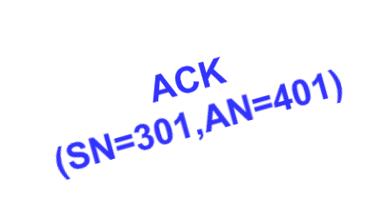
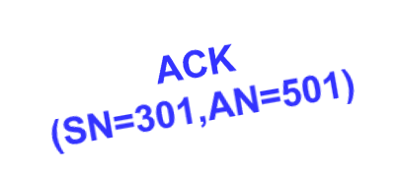
Data Transfer… (A -→ B)
A
B
Data
(SN=101, AN 301, 300)
DATA
Segment format
(SN, AN, Data size)
Data
(SN=401,AN=301,100)

Slide 30
TCP Header Format

Slide 31

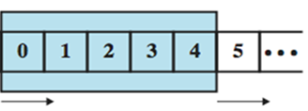
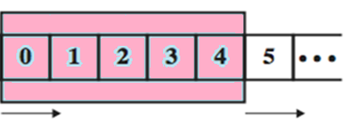
TCP Flow Control
So that sender won’t overrun receiver’s buffers by transmitting too much, too fast.
WHY?
Similar to sliding-window flow control in datalink layer, although some details are different.
HOW?
To support bi-directional data transfer, 2 pairs of windows are used:
A -> B: sender window
segment
A -> B: receiver window
B -> A: receiver window
B -> A: sender window
Host A
Host B

Slide 32
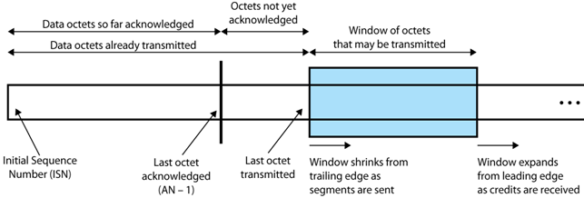
In sliding-window flow control, multiple segments are allowed to be in transit at the same time. The behaviour of sender is illustrated below:
Sender:
Maintain a blue window representing bytes that can be transmitted without ACK
When segment is sent, shrink blue window from trailing edge
Stop sending when blue window size = 0
When ACK is received, new blue window size = W bytes starting from AN.

Slide 33
In sliding-window flow control, multiple segments are allowed to be in transit at the same time. The behaviour of sender is illustrated below:
Window size since last acknowledgement
Sender:
Maintain a blue window representing bytes that can be transmitted without ACK
When segment is sent, shrink blue window from trailing edge
Stop sending when blue window size = 0
When ACK is received, new blue window size = W bytes starting from AN.

Slide 34
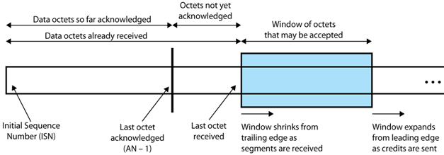
The corresponding behaviour of receiver in the sliding-window flow control is illustrated below:
Receiver:
Maintain a blue window representing bytes ready to accept
When segment is received, shrink blue window from trailing edge
If NOT ready to accept more segments, send ACK with credit W = remaining blue window size
If ready to accept more segments, send ACK with W > remaining blue window size, and expand blue window from leading edge

Slide 35
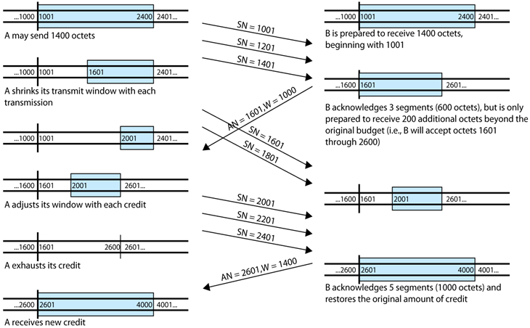
Here is an overall picture of how sliding-window flow control works:
Assume each segment carries 200 bytes of data.

Slide 36
TCP Flow Control Enhancement 1 – Delayed ACK (RFC 1122)
Problem: Wasteful to send ACK only segment (40 bytes
TCP+IP headers)
  Maximum < 500 ms, to avoid error-control timeout re-sent
  ACK every alternate segment received
  (Note: Piggy-backed ACK can be sent immediately)
sender
SN=257 (256 bytes)
receiver
Delayed ACK
(200 ms)
ACK (AN=513,W=2048)
SN=513 (256 bytes)
SN=769 (256 bytes)
ACK alternate segment
ACK (AN=1025,W=2048)
cumulative ACK

Slide 37
TCP Enhancement 2: avoiding Silly Window Syndrome at Receiver – Clark’s solution (RFC 813, RFC 1122)
Problem: Wasteful for receiver to keep ACK with small
window when sender can send more
Before:
…
After:
…
TCP rcvd window full
TCP rcvd window full
ACK (W=0)
ACK (W=0)
App read 1 byte
App read 1 byte
ACK (W=1)
1 byte
App read 1 byte
…
ACK (W=1)
App read 1 byte
ACK
(W=536)
1 byte
…
App read 1 byte
536 bytes
ACK (W=1)
…
ACK (W=0)
Solution: Receiver ACK W=0 instead of small window size until free buffer gets large; e.g. buffer half empty.

Slide 38
TCP Enhancement 3: avoiding Silly Window Syndrome at Sender - Nagle’s Algorithm (RFC 896, RFC 1122)
Problem: Wasteful for sender to keep sending small
segments when receiver can accept more
before
after
…
…
1 byte
1 byte
1 byte
1 byte
ACK
…
1 byte
…
…
1 byte
ACK
ACK
1 byte
1 byte
…
1 byte
ACK
1 byte
ACK
Solution: Send the 1st small segment, buffer the rest and send them together when ACK is returned.

Slide 39

TCP Error Control
So that TCP can guarantee reliable service to application layer even when IP is unreliable.
WHY?
Similar to Selective-Reject in datalink layer, but the details are different.
HOW?
Error types:
  Segments arriving out-of-order
    Detected based on SN in TCP header; re-order and ACK
  Segments duplicated
    Detected based on SN; discard and ACK
  Segments corrupted
    Detected based on checksum in TCP header
    Discard and wait for timeout retransmission
  Segments loss
    Wait for timeout retransmission

Slide 40
Examples of timeout retransmission scenarios
Lost data scenario
Lost ACK scenario
Host A
Host B
Host A
Host B
8 bytes (SEQ=92)
8 bytes (SEQ=92)
X
200 ms
timeout
timeout
ACK=100
X
8 bytes (SEQ=92)
8 bytes (SEQ=92)
ACK=100
ACK=100

Slide 41
Retransmission Timer
Problem: How long should TCP wait for the ACK before it retransmits that segment?
☹ Too short (premature timeout): there will be unnecessary retransmission
☹ Too long (slow reaction to losses): a long period of time is required to discover a lost segment
Note: Delays in network are constantly changing in
practice, so timeout must be adaptive.
Solution: Measure Round Trip Time (RTT) and compute smoothed RTT (SRTT). The Retransmission TimeOut (RTO) is then derived from SRTT.

Slide 42
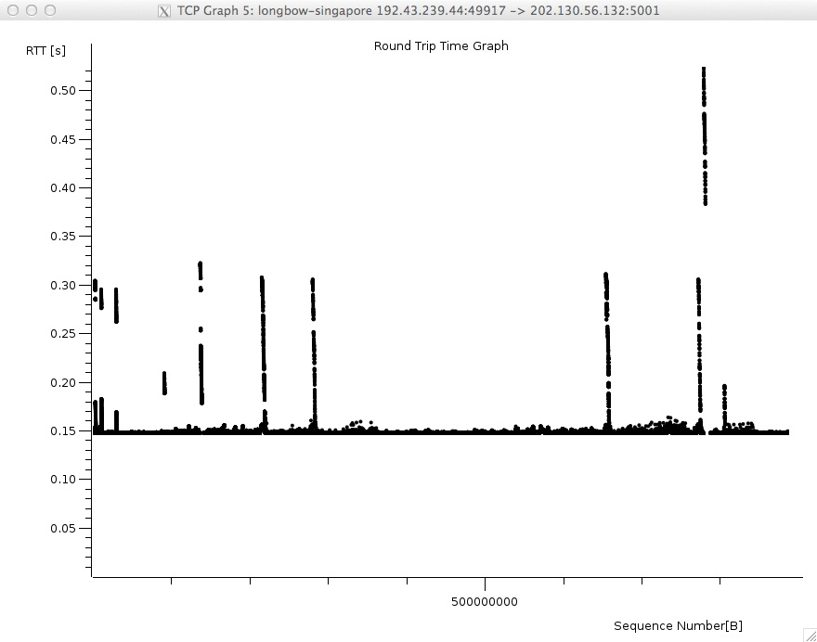
Notes:
It¹s the RTT not the one way trip that I use for latency/distance calculations. Speed of light is 3x10^8 m/s in vacuo - so assuming .66 refraction/electrical equipment etc - that¹s 2x10^8 m/s so that means about 100ms RTT (that¹s why the 2 is so nice) for 10,000 kms. I¹d suggest the distance involved is upto 14500 kms - Canberra/ Sydney/Guam/HK/Singapore. The shorter path Canberra/Perth/Singapore is upto 9,500 kms. Another way to look at it is flying time at most passenger jets can approach 1000km/h. The Pacific path is at least 290 or so ms - some 29K kms

Slide 43
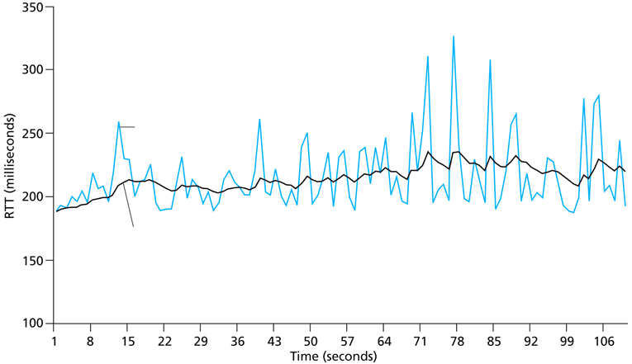
Example of RTT and SRTT
RTT
SRTT

Slide 44
Computing Retransmission Timer RTO – Jacobson’s Algorithm (RFC 6298)
Round | 10 | 11
SRTT | 20 | ((7/8)*20) + ((1/8)*16) = 19.5
RTTVAR | 10 | ((3/4)*10) + ((1/4)*4)= 8.5
RTT |  | 16
RTO | 60 | 53.5
Initialization:
RTO = 1 (s)
After 1st RTT is measured:
(smoothed RTT) SRTT = RTT
(RTT variation) RTTVAR = RTT/2
RTO = SRTT + 4×RTTVAR
After each subsequent RTT is measured:
RTTVAR = (1-β)×RTTVAR + β×|SRTT - RTT| , β = 1/4
SRTT = (1-α)×SRTT + α×RTT , α = 1/8
RTO = SRTT + 4×RTTVAR
(minimum) 1s ≤ RTO ≤ maximum (at least 60s)
Notes:
RTTVAR is the delayed variance. The measured is in sub-seconds although is calculated in seconds.

Slide 45
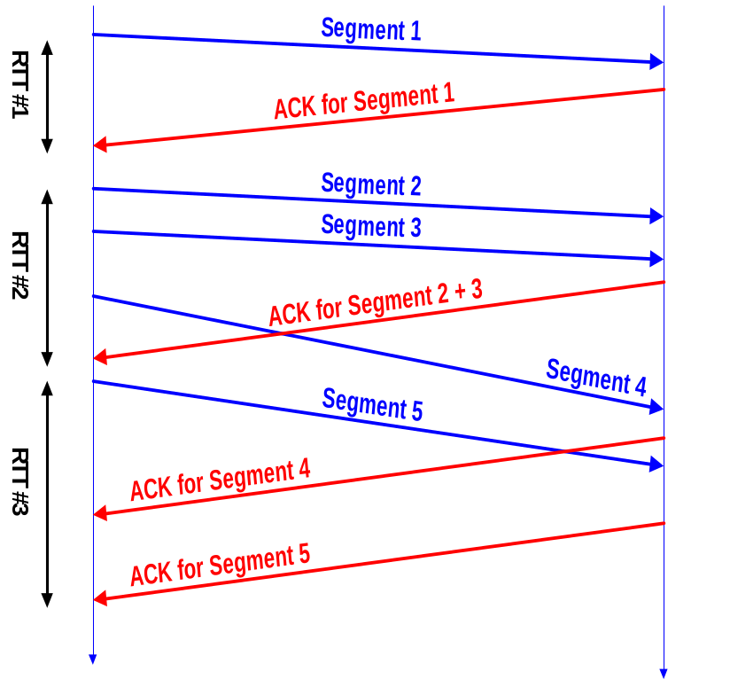
Measuring RTT – Karn’s Algorithm (RFC 1122)
Each TCP connection measures the RTT from sending a segment to receiving its corresponding ACK.
Typically, there is only one measurement ongoing at any time (i.e. measurements do not overlap).
Karn’s Algorithm:
If a segment is retransmitted due to timeout, ignore its measured RTT because it is ambiguous whether the ACK is for 1st or re-transmission.
When retransmission occurs, set RTO = 2 × RTO

Slide 46
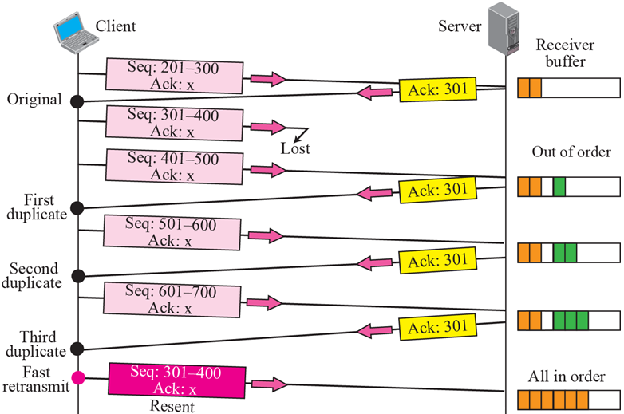
TCP Error Control Enhancement – Fast Retransmit
Fast retransmit if receiving 3 duplicate ACKs instead of waiting for timeout.
Not timeout yet

Slide 47
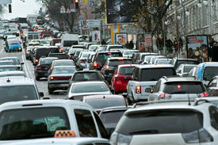


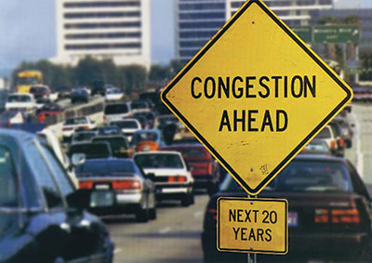
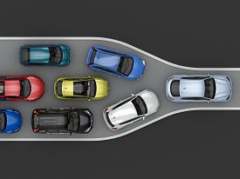
Congestion

Slide 48
Congestion Control
To prevent senders from sending too much traffic to the network such that it becomes overly congested and useless; informally, to be a “considerate user” of the network
WHY?
Implement congestion control algorithm with a congestion window which controls the amount of traffic that a connection can send
HOW?

Slide 49
What will happen if network congestion is ignored? Congestion Collapse!
Goodput
(output)
Ideal case
(no retransmission)
Reality
Congestion collapse
Load (input)
◆  
Output = Input + Retransmission
◆ Zero retransmission, hence Output = Input
❖ Several retransmissions, hence output continues to increase slightly as input increases
⬥ Transmissions are dominated by retransmissions

Slide 50
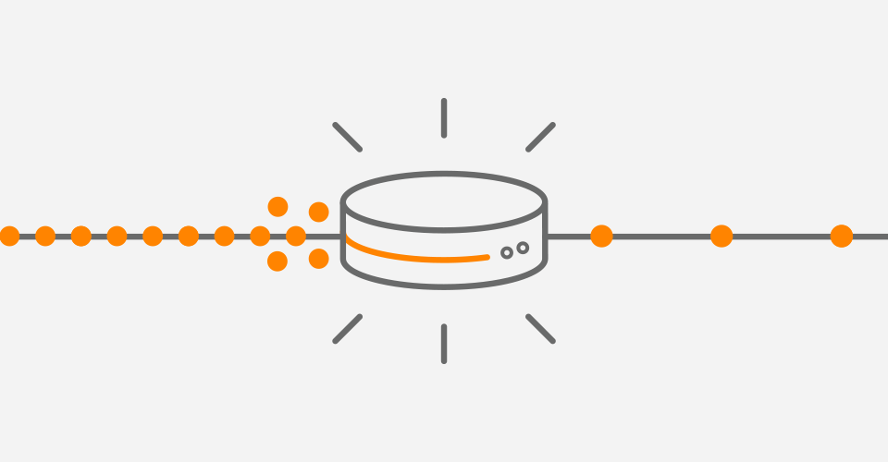
Congestion Control
TCP sender assumes network congestion when LOSS events occurred:
  Timeout or receiving duplicate ACKs
    Possibly due to queueing or buffer overflow at
    routers which are signs of congestion

Slide 51
TCP Congestion Control
Two phases
  Slow Start
  Congestion Avoidance
Two parameters:
  cwnd: Congestion Window, measured in number of MSS (maximum segment size, typically 536 bytes, but can be changed by using TCP options field).
  ssthresh: Slow Start Threshold defines the point to transit from slow start to congestion avoidance phase; in practice, typically set large value for initial ssthresh (half- maximum number of MSS)
Note: With congestion control, maximum data bytes that can be sent without ACK = min { W, cwnd x MSS }
Window size in bytes
Convert to bytes

Slide 52

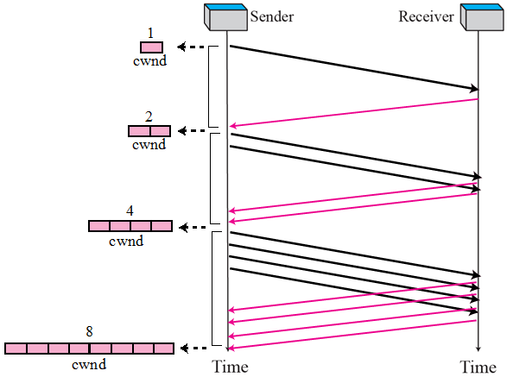
TCP Slow Start Phase
Slow start
initialize: cwnd = 1
do
for (each segment ACKed)
cwnd++
until (loss event OR cwnd≥ssthresh)
1st
2nd
Go to recovery
Go to congestion avoidance
cwnd increases exponentially at each transmission round (not so slow after all!)
3rd transmission round

Slide 53
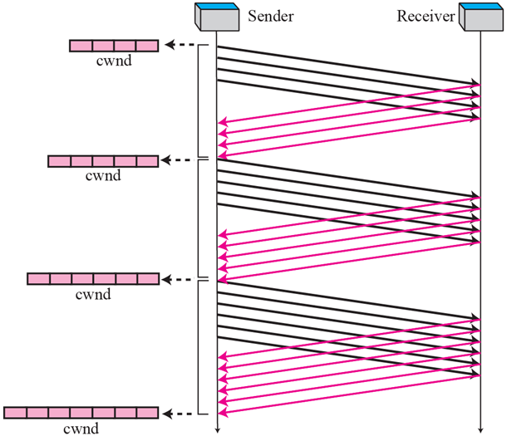

TCP Congestion Avoidance Phase
ssthresh = 4
Congestion avoidance
/* slow start is over */
/* cwnd ≥ ssthresh */
do
for (every segment ACKed)
cwnd += 1/ cwnd
until (loss event)
i-th round
5
(i+1)-th round
Go to recovery
6
In contrast, cwnd only increases linearly at each transmission round.
(i+2)-th round
7

Slide 54
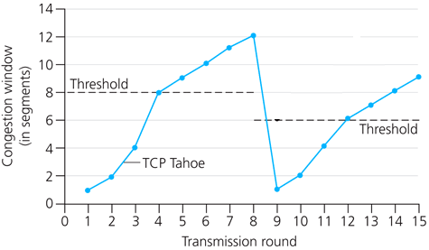

TCP Congestion Control – Tahoe Algorithm
Recovery
ssthresh = cwnd/2
cwnd = 1
go back to slow start
floor function
cwnd

Slide 55
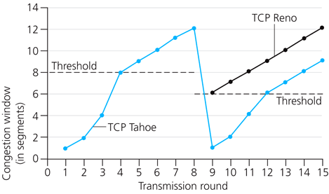
TCP Congestion Control – Reno Algorithm: Implement Fast Recovery
Recovery
ssthresh = cwnd/2
if loss == 3 duplicate ACKs {
cwnd = ssthresh
go to collision avoidance }
else
if loss == timeout {
cwnd = 1
go to slow start }
Rationale: Network is not too congested if other segments are getting through.
3 duplicate ACKs

Slide 56
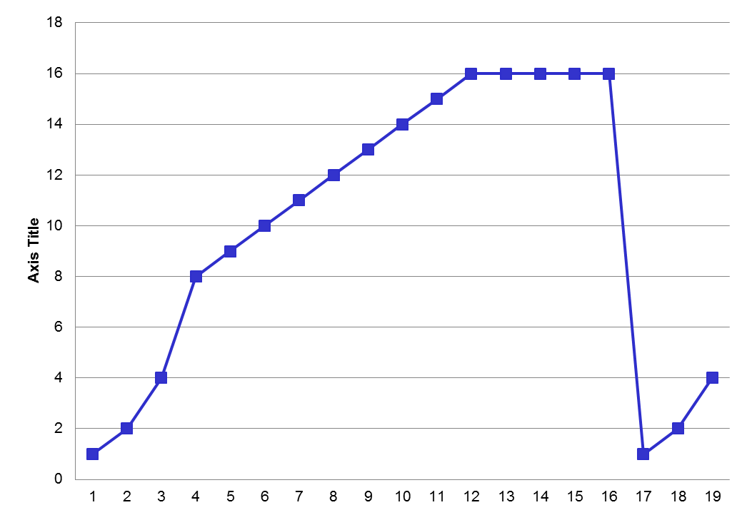
TCP Congestion Control
Max
MSS window
size
Congestion
avoidance
Congestion window
(in segments)
SSthresh
SSthresh
Slow-start
Assume:
Maximum MSS window size is 16
Transmission round

Slide 57
Calculation of TCP throughput
TCP Throughput
  (cwnd * MSS) / RTT = throughput
    Assume ((cwnd *MSS* 8)/ Transmission rate) <<< RTT
    Assume no buffer constraint.
Max
MSS window
size
MSS = 1000 B
RTT = 1 second
Max throughput
= 16 x MSS/1
= 16KB per sec.
= 128 Kbps
Congestion
avoidance
Congestion window
(in segments)
SSthresh
SSthresh
Slow-start
Transmission round

Slide 58
Summary of Transport Layer
Application layer
ports
UDP
unreliable service
connectionless
TCP
reliable service
connection-oriented
connection management
flow & error control
congestion control
Transport
layer
Network layer (IP)

